Slide 1
Measures of Central Tendency Measures of Variability

Slide 2
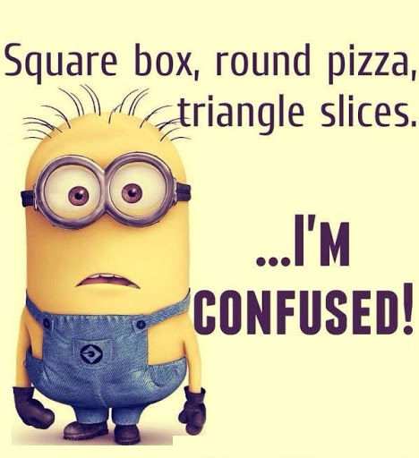
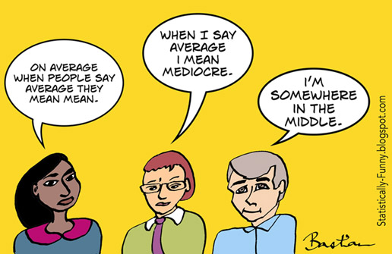
Where to start??
Categorical Data
Counts
Percentages
Crosstabs – Rows and Columns
Mode
Numerical Data- Most common way to summarize a numerical data is to describe where the center is:
Mean
Median
Outliers – Numbers in a dataset that are
extremely high or low compared to the rest

Slide 3
Measure of Central Tendency
A measure of central tendency is a single value that attempts to describe a set of data by identifying the central position within that set of data
They are also classed as summary statistics.
Mean: The "average" number; found by adding all data points and dividing by the number of data points.
Example: The mean of 4, 1, and 7 is (4+1+7)/3 = 12/3 = 4
Median: The middle number; found by ordering all data points and picking out the one in the middle (or if there are two middle numbers, taking the mean of those two numbers).
Example: The median of 4, 1, and 7 is 4 because when the numbers are put in order (1, 4, 7) , the number 4 is in the middle.
Mode: The most frequent number—that is, the number that occurs the highest number of times.
Example: The mode of {4, 2, 4, 3, 2, 2} is 2 because it occurs three times, which is more than any other number.

Slide 4
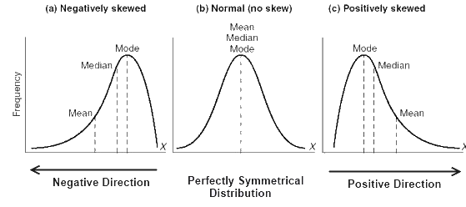
Empirical Relation Between Mean, Median And Mode
A distribution in which the values of mean, median and mode coincide (i.e. mean = median = mode) is known as a symmetrical distribution.
When values of mean, median and mode are not equal the distribution is known as asymmetrical or skewed distribution
In such distributions the distance between the mean and median is about one-third of the distance between the mean and mode
Mean – Median = 1/3(Mean – Mode) , or
Mean - Mode = 3( Mean – Median)

Slide 5
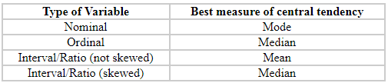
When to use what?
Mean:
An important property of the mean is that it includes every value in your data set as part of the calculation.
The mean is the only measure of central tendency where the sum of the deviations of each value from the mean is always zero.
The mean has one main disadvantage: it is particularly susceptible to the influence of outliers.
Median:
Not as strongly influenced by the outliers.
Time when we usually prefer the median over the mean (or mode) is when our data is skewed.
Mode:
Sometimes the mode is considered as being the most popular option.
Normally, the mode is used for categorical data where we wish to know which is the most common category
Problem with the mode is that it will not provide us with a very good measure of central tendency when the most common mark is far away from the rest of the data in the data set

Slide 6
Measure of Variability
Variability refers to how "spread out" a data is
There are four frequently used measures of variability: the range, interquartile range, variance, and standard deviation
Lets understand this with a help of an example:
The scores of three batsman in the three matches played are as given below:
 | Rohit Sharma | Virat Kohli | MS Dhoni
Match 1 | 5 | 95 | 50
Match 2 | 280 | 100 | 100
Match 3 | 15 | 105 | 150
The average runs scored by all three is 100 runs. If you have to pick only one batsman for the next match, which
one will you pick and why??

Slide 7
Range:
The range is the simplest measure of variability to calculate
The range is simply the highest score minus the lowest score
Lower the range, lower the variability in the data
Interquartile range:
Percentiles
We saw that the median splits the data so that half lies below the median. Often we are interested in the percent of the data that lies below an observed value.
We call the r^{th} percentile the value such that r percent of the data fall at or below that value.
Example: Suppose the test scores were
22, 34, 68, 75, 79, 79, 81, 83, 84, 87, 90, 92
If your score was the 75, in what percentile did you score? – Ans 25 percentile
Which score will result in 60 percentile – Ans 83
The second quartile (Q₂) is the median or the 50th percentile
The first quartile (Q₁) is the median of the data that falls below the median. This is the 25th percentile
The third quartile (Q₃) is the median of the data falling above the median. This is the 75th percentile
IQR = Q₃ - Q₁

Slide 8
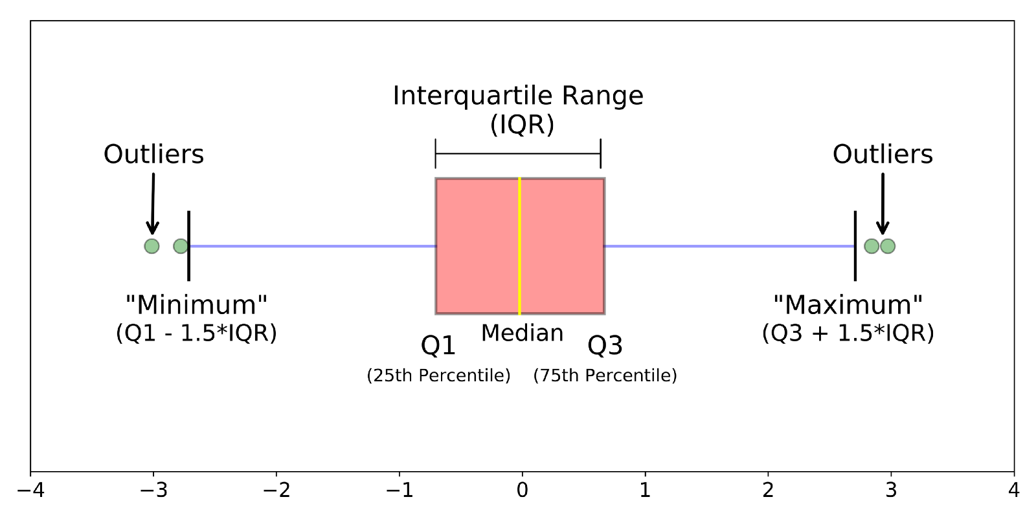
Important to cover Box Plot here….
Boxplots are a standardized way of displaying the distribution of data based on a five number summary (“minimum”, first quartile (Q1), median, third quartile (Q3), and “maximum”).
interquartile range (IQR): 25th to the 75th percentile.
whiskers (shown in blue)
outliers (shown as green circles)
“maximum”: Q3 + 1.5*IQR
“minimum”: Q1 -1.5*IQR

Slide 9
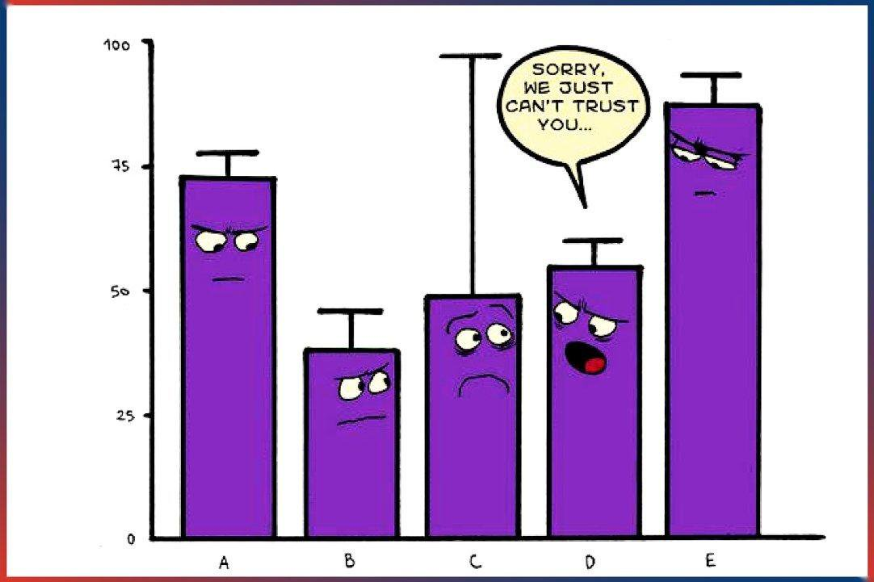


Here are the types of observations one can make from viewing a Box Plot:
What the key values are, such as: the average, median 25th percentile etc.
If there are any outliers and what their values are.
Is the data symmetrical.
How tightly is the data grouped.
If the data is skewed and if so, in what direction.
Variance:
Variability can also be defined in terms of how close the scores in the distribution are to the middle of the distribution
Variance is defined as the average squared difference of the scores from the mean
If the variance in a sample is used to estimate the variance in a population, then the previous formula underestimates the variance and the following formula should be used:
Scores | Deviation from Mean | Squared Deviation
9 | 1 | 1
9 | 1 | 1
9 | 1 | 1
7 | -1 | 1
6 | -2 | 4
8 | 0 | 0
Means
8 | 0 | 1.33
The formulae is :
N – Number of numbers
μ - Mean

Slide 10
Standard Deviation:
The standard deviation is simply the square root of the variance
The standard deviation is an especially useful measure of variability when the distribution is normal or approximately normal
Standard deviation is also useful when comparing the spread of two separate data sets that have approximately the same mean
The data set with the smaller standard deviation has a narrower spread of measurements around the mean and therefore usually has comparatively fewer high or low values
An item selected at random from a data set whose standard deviation is low has a better chance of being close to the mean than an item from a data set whose standard deviation is higher.
Standard deviation is never negative.
Standard deviation is sensitive to outliers
If all values of a data set are the same, the standard deviation is zero
The standard deviation is expressed in the same units as the mean is, whereas the variance is expressed in squared units

